Slide 1
Logistic Regression Model
SAS Project By
Dhivya Murugesan

Slide 2
Loan Risk Model Predict …
Who, amongst existing loan customers, are more likely to be default (bad)?
Good Accounts
Existing Loan Customers
At the month
of 18
Bad accounts
Definition of Default (Bad):
  Default is failure to meet the legal obligations (or conditions) of a loan, for example when a home buyer fails to make a mortgage payment, or when a corporation or government fails to pay a bond which has reached maturity.

Slide 3

Methodology and Data Partition
Methodology -- Logistic Regression
Sampling Population
Calibration Sample
Validation Sample
Random Sample of 60%
Random Sample of 40%

Slide 4
Modeling Process
Modeling data set has 14 independent variables, and one dependant binary variable.
Dependant Variable: bad=1, non-bad=0.
Preliminary variable transformations through Rank & Plot.
Logistic Regression
logit(P / (1-P))= α + β1x1 + β2x2 + ... + βNxN, using stepwise selection technique
Correlation between variables, model concordance and goodness-of-fit are used to select the best-fit model

Slide 5
Model Result: Logit Equation
Logit =
-1.6681
+2.6993 * DEBTINC_MISS /*Debt to income ratio IS MISSING */
+3.6737 * Value_Miss /*Value of current property IS MISSING */
-0.00703 * clage /*Age of oldest trade line in months*/
+0.6793 * delinq /*Number of delinquent trade lines*/
+0.6063 * derog /*Number of major derogatory reports*/
+0.1243 * ninq /*Number of recent credit inquiries*/
-0.0279 * yoj /*Years on current job*/
prob=1/(1+exp(-logit));
run;
Drivers
CF with + is positive driver.
Positive drivers are:
Debtinc_Miss
Value_Miss
Delinq
Derog
Ninq
Suppressors
CF with – is negative driver:
Negative drivers are:
Clage
Yoj

Slide 6
Summary of Model Results
Analysis of Maximum Likelihood Estimates
Parameter | DF | Estimate | Standard Error | Wald Chi-Square | Pr > ChiSq | Standardized Estimate
Intercept | 1 | -1.6681 | 0.1569 | 113.0120 | <.0001
DEBTINC_MISS | 1 | 2.6993 | 0.1146 | 554.9085 | <.0001 | 0.6126
VALUE_MISS | 1 | 3.6737 | 0.5325 | 47.6034 | <.0001 | 0.2678
CLAGE | 1 | -0.00703 | 0.000832 | 71.5295 | <.0001 | -0.2847
DELINQ | 1 | 0.6793 | 0.0564 | 144.8049 | <.0001 | 0.3861
DEROG | 1 | 0.6063 | 0.0717 | 71.5015 | <.0001 | 0.2689
NINQ | 1 | 0.1243 | 0.0295 | 17.6999 | <.0001 | 0.1163
YOJ | 1 | -0.0279 | 0.00710 | 15.3923 | <.0001 | -0.1316
Association of Predicted Probabilities and Observed Responses
Percent Concordant | 88.9 | Somers' D | 0.779
Percent Discordant | 11.0 | Gamma | 0.779
Percent Tied | 0.0 | Tau-a | 0.252
Pairs | 2087904 | c | 0.890

Slide 7
Model Validation Process
To ensure model performs well on future unseen data, model is tested on the validation data.
The validation data set is not used for model development.
KS-Test (Kolmogorov Smirnov Statistics) algorithm is used for model validation. The result is based on Maximum-KS, observed lift value, and smoothness of the lift curve.

Slide 8
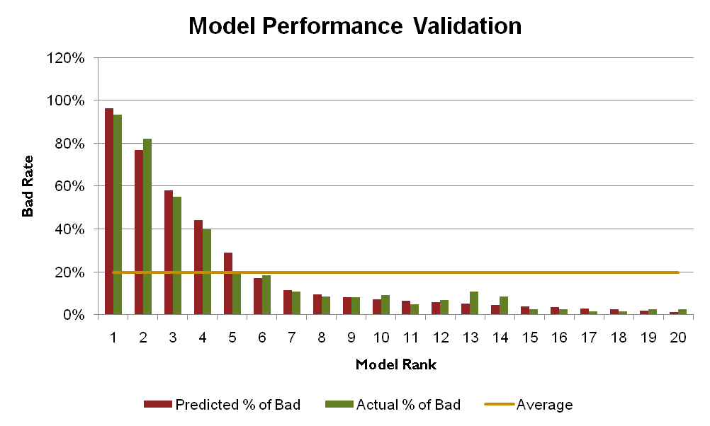
Model Validation
The predicted bad rate in top quantile is 96.3%, compare to an average of 19.8% based on the Validation data set. The model results a lift of almost 5 in the top quantile.

Slide 9
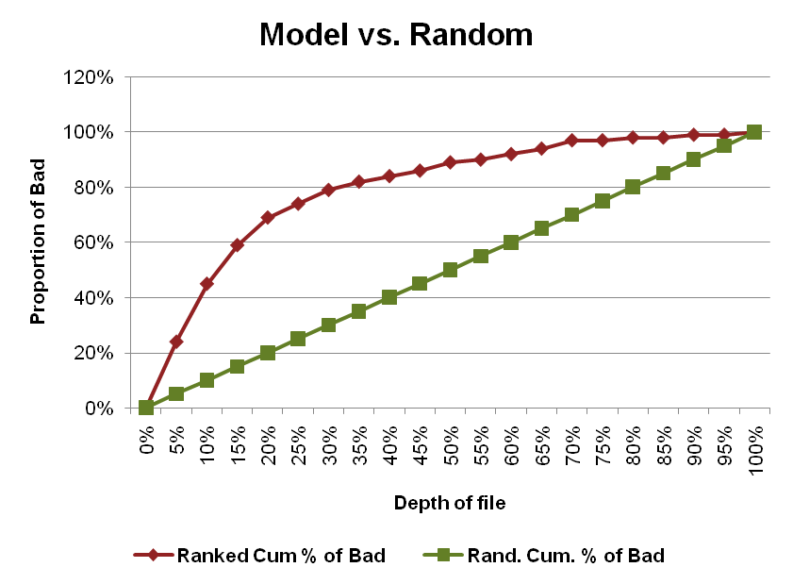
Validation - KS-Test Chart
The diagonal line illustrates the number of bad expected from a randomly selected target audience.
The top curve represents the expected bad if the model scores determine the target audience.
80% of Bad are captured by the top 30% of the file.

Slide 10
Validation - KS-Test Chart
The diagonal line illustrates the number of bad expected from a randomly selected target audience.
The top curve represents the expected bad if the model scores determine the target audience.
80% of Bad are captured by the top 30% of the file.

Slide 11
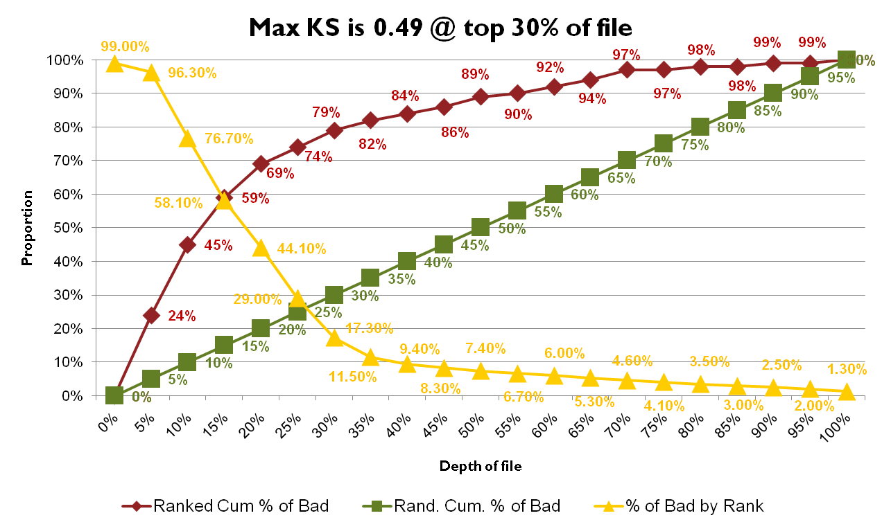
Validation - KS-Test Chart
80% of Bad are captured by the top 30% of the file.

Slide 12
Comments and Recommendations
The performance of the model is good. The logistic model Concordance Rate is reasonable(89%), and the variables entered into the final regressions make business sense.
Max_KS (0.49) is attained at 30% of the ranked file, meaning that at this point, we capture the highest proportion of bad and the lowest proportion of good.
The model results are presented in very simple fashion by model score which is assigned to selected customers. This score is from 0 to 1, 1 being the certainty of bad, 0 being the opposite.

Slide 13
Thank You
Dhivya Murugesan mdhivya.it@gmail.com

